Slide 1
E-COMMERCE APPLICATION ON IBM CLOUD FOUNDRY
Srividhya S
912421104044

Slide 2

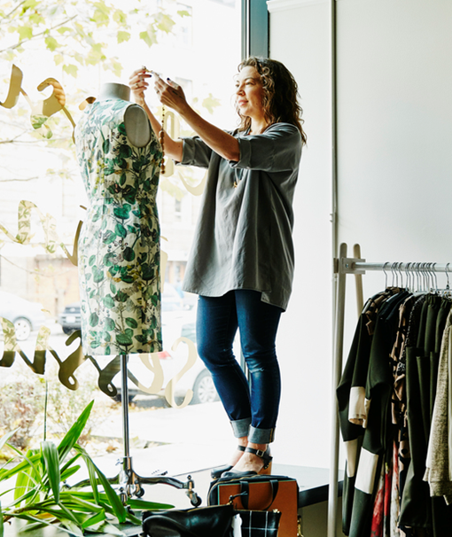

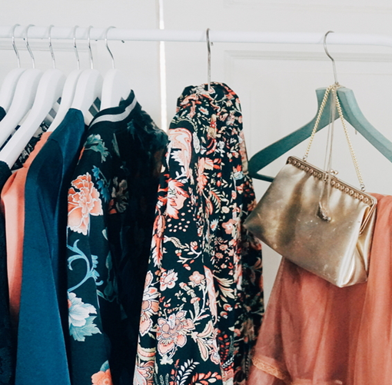
Phase 1 project
Problem Definition
Design Thinking

Slide 3
Problem Definition:
This project is to build an artisanal e-commerce platform using IBM cloud foundry . The goal is to connect skilled artisanal with a global audience showcasing their handmade products and providing features like secure shopping carts payment gateways and an intuitive checkout process. This involves designing the ecommerce platform, implementing necessary features , and ensuring a seamless user experience. Ensure that the application is intuitive and easy to use, with a user-friendly interface that facilitates product search, selection, and purchase. Ensure the application is highly available and reliable, minimizing downtime and disruptions to customers.

Slide 4
Design your thoughts
DESIGN THINKING

Slide 5
DESIGN THINKING:
Platform Design
Product Showcase
User Authentication
Shopping card And Checkout
Payment Integration
User Experience

Slide 6
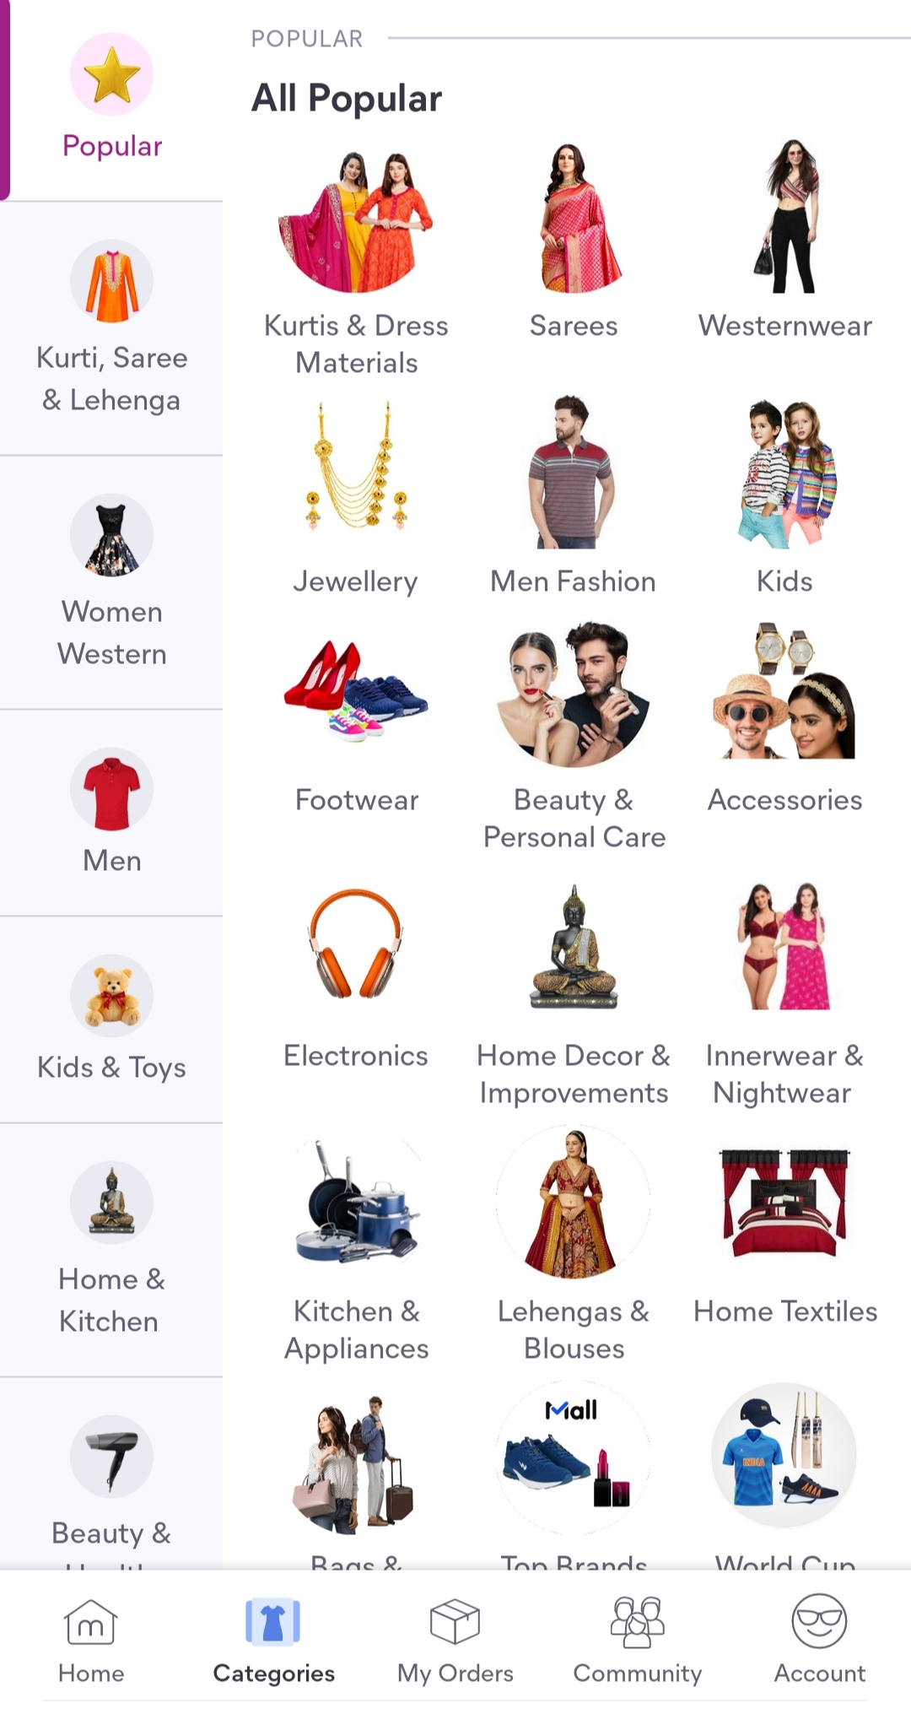
PLATFORM DESIGN:
Top categories to choose from
Design the platform layout with sections for product categories, individual product pages , shopping cart , checkout and payment. Product Categories:
Below the header, create a section for product categories. This section should display images and text links to different product categories.
Each category image should be a clickable link leading to a category page.

Slide 7
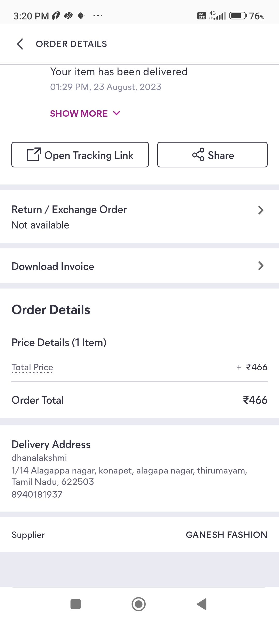
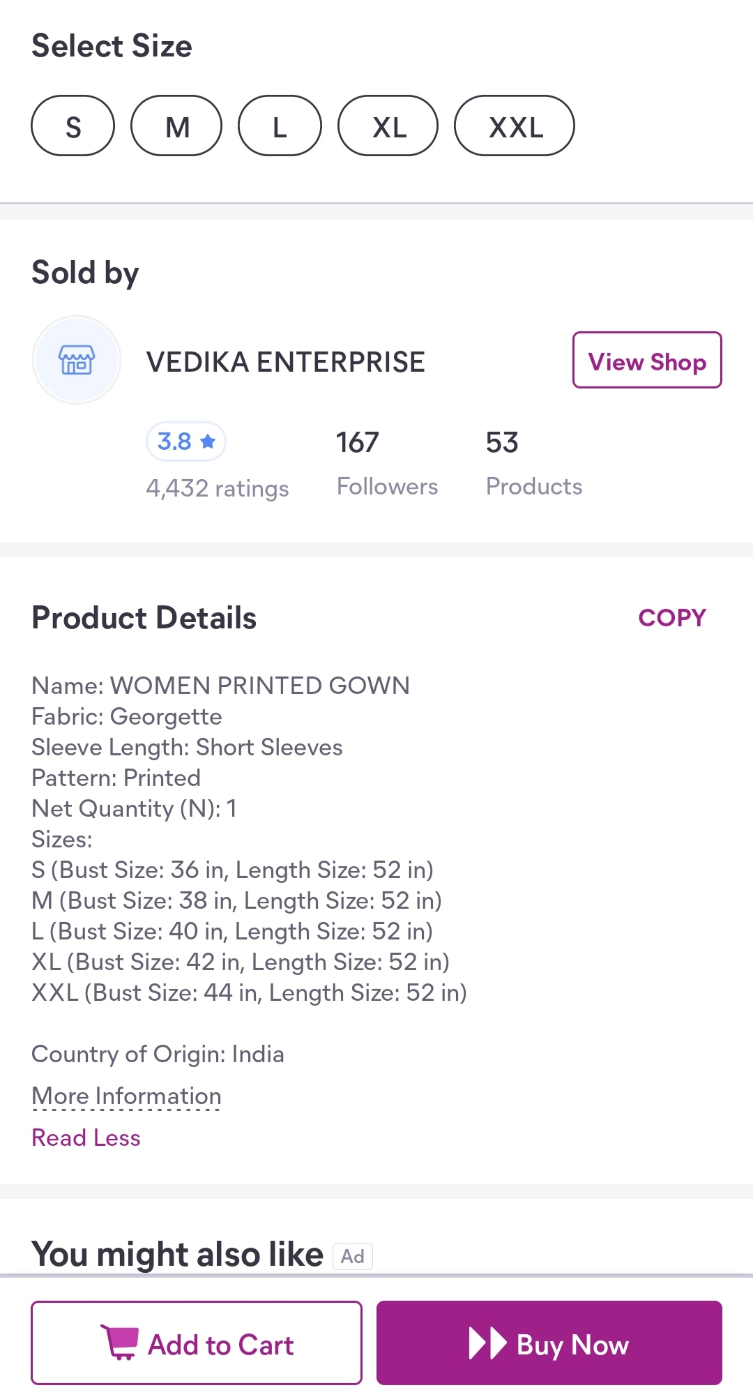
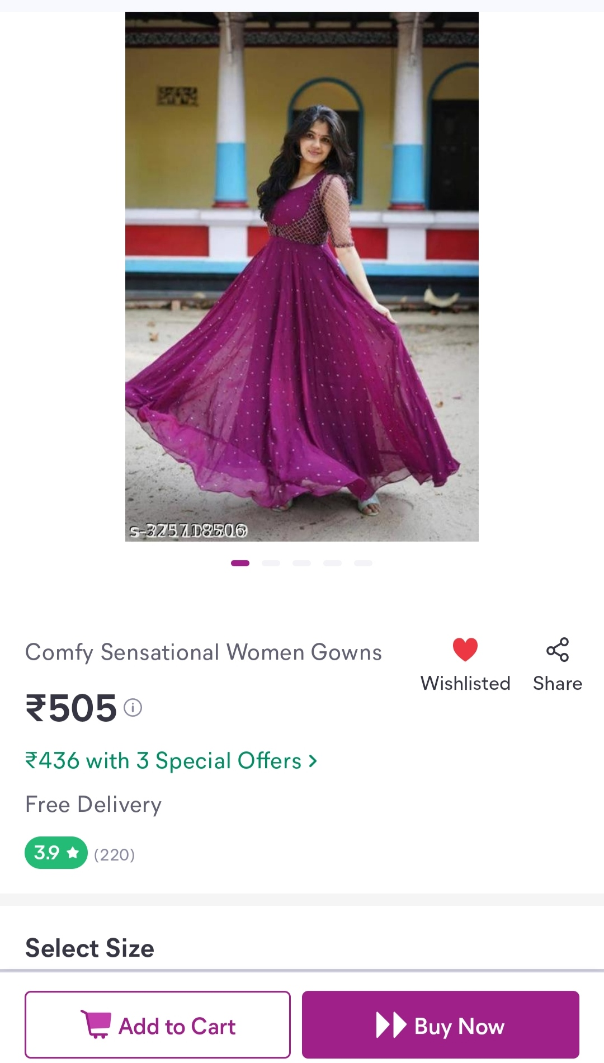
Individual product pages : •Each product should have an image, product name, price, and an "Add to Cart" button
.
.
Shopping cart and checkout payment:
• After adding items to the cart, users can proceed to checkout.
• On the checkout page, provide various payment options such as credit/debit card, PayPal, or other

Slide 8
PRODUCT SHOWCASE:
Create a database to store product information such as images, descriptions, prices and categories.
Products Table
Attributes:ProductID (Primary Key, Auto -incremented),ProductName (String),Description (Text),Price (Decimal),CategoryID (Foreign Key),ImageURL (String)
Categories Table:
Attributes:CategoryID (Primary Key, Auto - incremented),CategoryName (String)
Use Cases From Backend
Product Listing: Retrieve a list of products with their names, prices, and images for displaying on the website.
Sql query: SELECT ProductName, Price, ImageURL FROM
Category Filtering: Allow users to filter products by category by querying the "Products" table based on the CategoryID field.
Sql query: SELECT ProductName, Price, ImageURL
FROM Products
WHERE CategoryID = category_id; Products: Remove products from the database when they are no longer available. Sql query:DELETE FROM Products WHERE ProductID = product_id

Slide 9
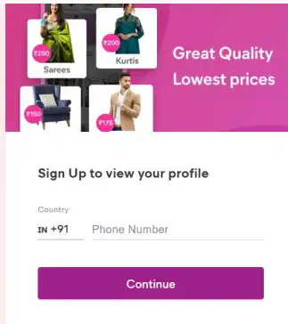
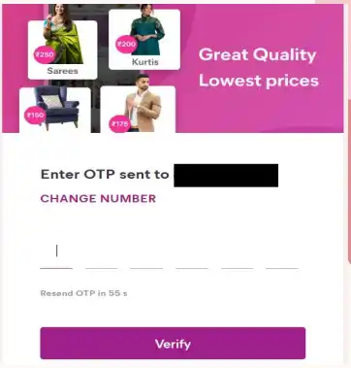
USER AUTHENTICATION: Presentation title 10 Implement user registration and authentication features to enable artisans and customers to access the platform

Slide 10
SHOPPING CART AND CHECKOUT:
Design and develop the shopping cart functionality and a smooth checkout process.
.
.
Shopping Cart Functionality: Include a shopping cart icon or link in the website's header to give users easy access to their cart.
Smooth Checkout Process: Create a multi-step checkout process, with each step clearly labeled
Order Confirmation: Display a confirmation message and order number to users after successfully placing an order
Error Handling and Validation: Implement robust error handling to gracefully manage issues such as payment failures, invalid addresses, or out-of-stock items.
Testing: Thoroughly test the entire checkout process with real and simulated transactions to identify and resolve any issues

Slide 11

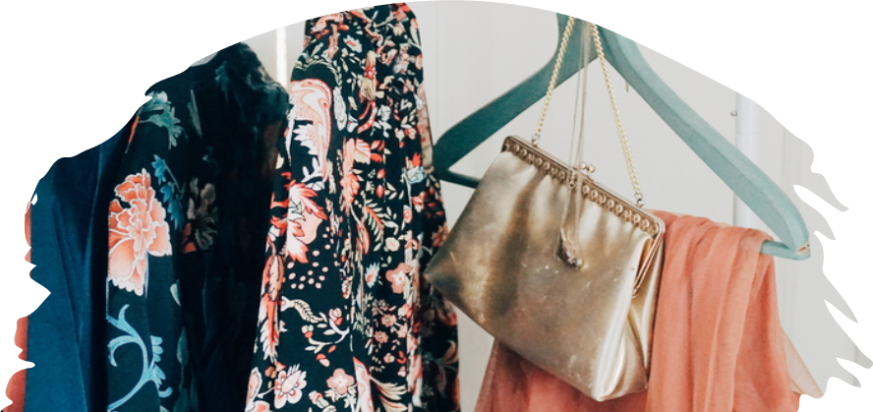
PAYMENT INTEGRATION:
Integrate secure payment gateways to facilitate transactions

Slide 12
Focus on providing an intuitive and visually appealing user experience for both artisan
USER EXPERIeNCE:

Slide 13
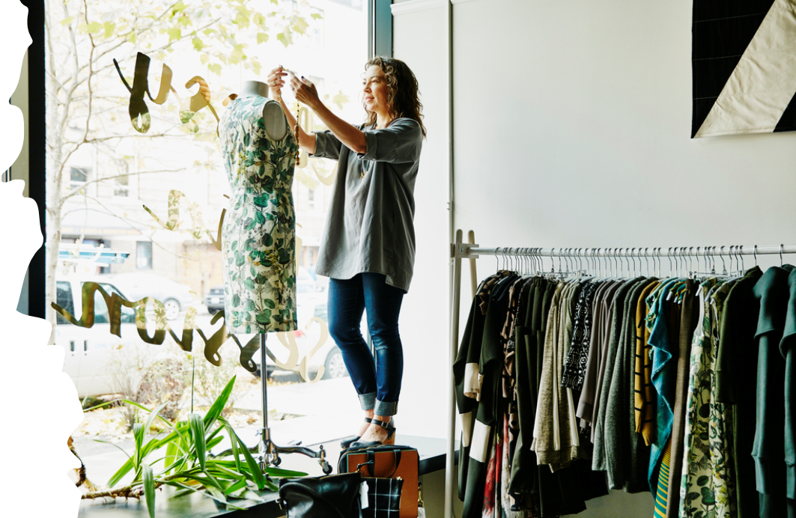

Thank you
SRIVIDHYA S
srividhya434500@gmail.com

